Slide 1

Computer System Servicing

Slide 2

Motivation:

Slide 3
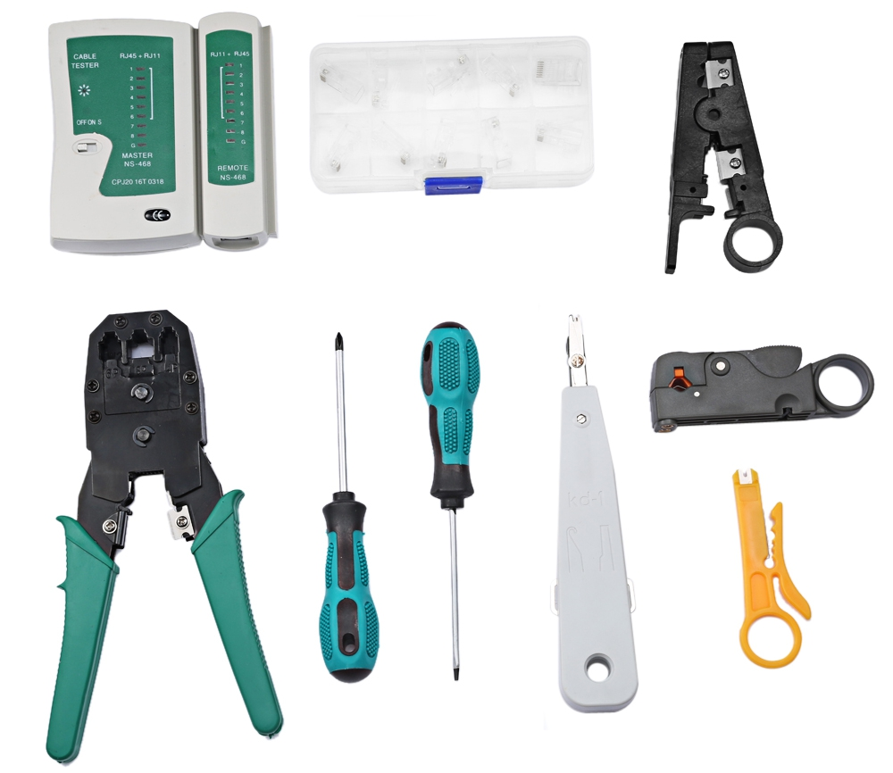
Network Materials, Tools and Testing Devices

Slide 4
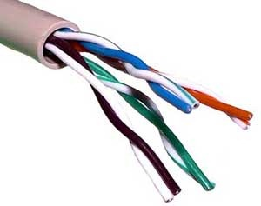
Network Materials
TWISTED-PAIR CABLE
Are cables that are specially used in networking.

Slide 5
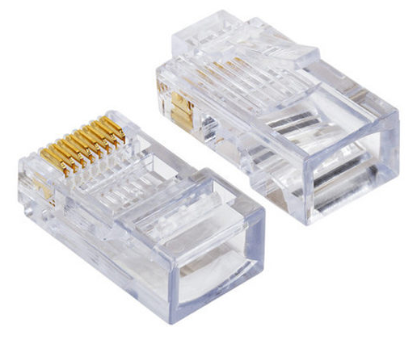
Network Materials
2. RJ 45
A connector attached to the end of a twisted-pair cable.

Slide 6
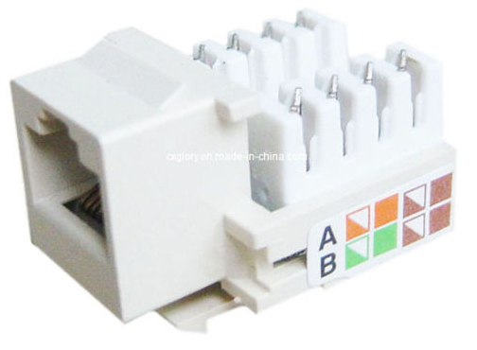
Network Materials
3. Krone Jack
A unique locking system that prevents accidental unplugging resulting from shock and vibration.

Slide 7
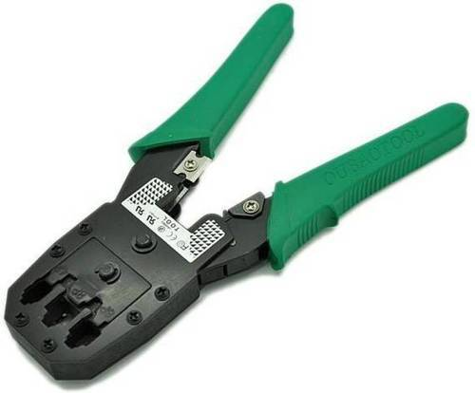
Network Tools and Testing Device
1. CRIMPING TOOL
This is a special tool used to cut, hold, and attach an RJ45 jack to the end of the cable.

Slide 8
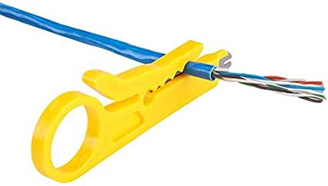
Network Tools and Testing Device
2. WIRE STRIPPER
Use to cut and strip wire for matching different cable sizes.

Slide 9
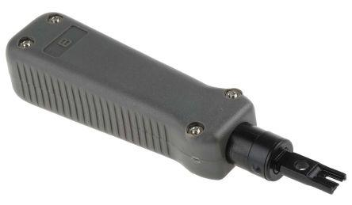
Network Tools and Testing Device
3. PUNCH DOWN TOOL/IMPACT TOOL
Use to connect wires to patch panel and modular jack/Krone Jack.

Slide 10
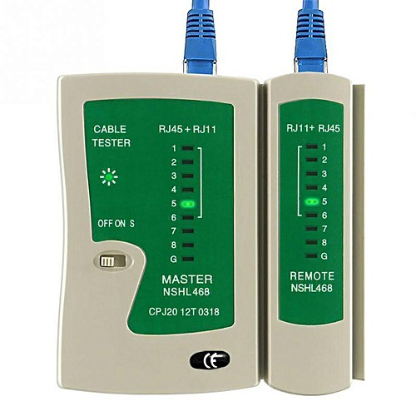
Network Tools and Testing Device
4. LAN TESTER
An electronic device used to verify the connection in a signal cable.

Slide 11
FORMATIVE ASSESSMENT
Direction: Give one Example of each;
Network Materials
Network Tools
Network Testing Device

Slide 12
Practical Application of the acquired
Learning Competencies

Slide 13

GENERALIZATION

Slide 14
THANK YOU!!!

